Slide 1
AERODYNAMICS
د. محمد خضير عباس

Slide 2
Chap.4
Incompressible Flow over Airfoils

Slide 3
OUTLINE
Airfoil nomenclature and characteristics
The vortex sheet
The Kutta condition
Kelvin’s circulation theorem
Classical thin airfoil theory
The cambered airfoil
The vortex panel numerical method

Slide 4
Airfoil nomenclature and characteristics
Nomenclature

Slide 5
Characteristics

Slide 6
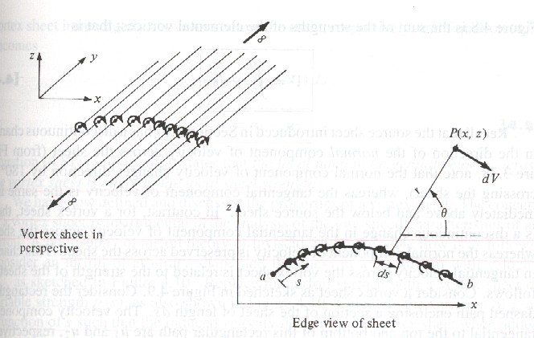
The vortex sheet
Vortex sheet with strength γ=γ(s)
Velocity at P induced by a small section of vortex sheet of strength γds
For velocity potential (to avoid vector addition as for velocity)

Slide 7
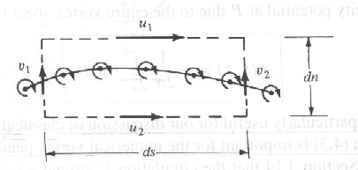
The velocity potential at P due to entire vortex sheet
The circulation around the vortex sheet
The local jump in tangential velocity across the vortex sheet is equal to γ.

Slide 8
Calculate γ(s) such that the induced velocity field when added to V∞ will make the vortex sheet (hence the airfoil surface) a streamline of the flow.
The resulting lift is given by Kutta-Joukowski theorem
Thin airfoil approximation

Slide 9
The Kutta condition
Statement of the Kutta condition
The value of Γ around the airfoil is such that the flow leaves the trailing edge smoothly.
If the trailing edge angle is finite, then the trailing edge is a stagnation point.
If the trailing edge is cusped, then the velocity leaving the top and bottom surface at the trailing edge are finite and equal.
Expression in terms of γ

Slide 10
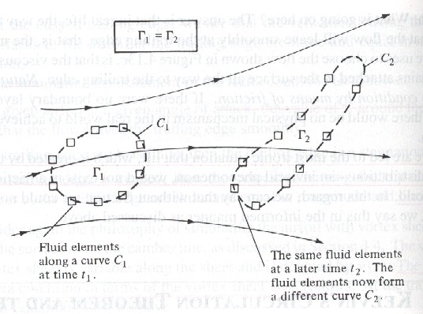
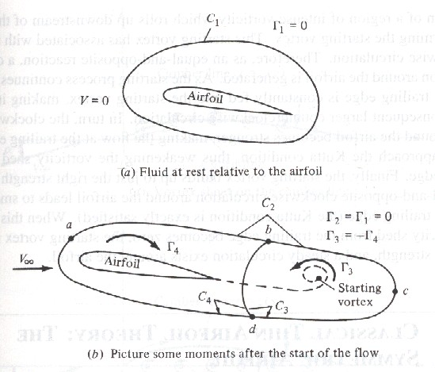
Kelvin’s circulation theorem
Statement of Kelvin’s circulation theorem
The time rate of change of circulation around a closed curve consisting of the same fluid elements is zero.

Slide 11
Classical thin airfoil theory
Goal
To calculate γ(s) such that the camber line becomes a streamline.
Kutta condition γ(TE)=0 is satisfied.
Calculate Γ around the airfoil.
Calculate the lift via the Kutta-Joukowski theorem.

Slide 12
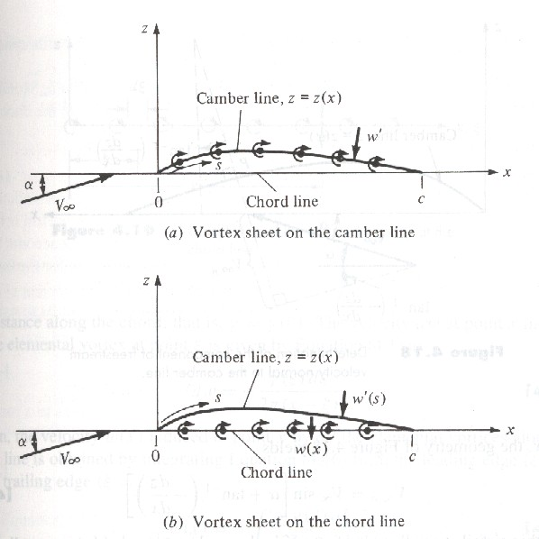
Approach
Place the vortex sheet on the chord line, whereas determine γ=γ(x) to make camber line be a streamline.
Condition for camber line to be a streamline
where w'(s) is the component of velocity normal to the camber line.

Slide 13
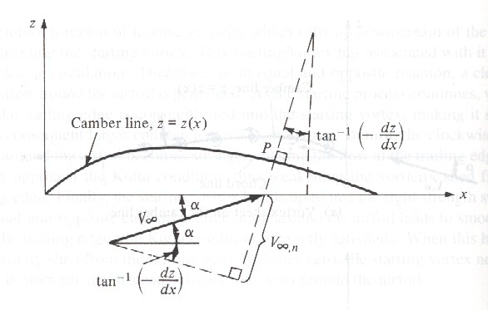
Expression of V∞,n
For small α

Slide 14
Expression for w(x)
Fundamental equation of thin airfoil theory

Slide 15
For symmetric airfoil (dz/dx=0)
Fundamental equation for γ(ξ)
Transformation of ξ, x into θ
Solution

Slide 16
Check on Kutta condition by L’Hospital’s rule
Total circulation around the airfoil
Lift per unit span

Slide 17
Lift coefficient and lift slope
Moment about leading edge and moment coefficient

Slide 18
Moment coefficient about quarter-chord
For symmetric airfoil, the quarter-chord point is both the center of pressure and the aerodynamic center.

Slide 19
The cambered airfoil
Approach
Fundamental equation
Solution
Coefficients A0 and An

Slide 20
Aerodynamic coefficients
Lift coefficient and slope
Form thin airfoil theory, the lift slope is always 2π for any shape airfoil.
Thin airfoil theory also provides a means to predict the angle of zero lift.

Slide 21
Moment coefficients
For cambered airfoil, the quarter-chord point is not the center of pressure, but still is the theoretical location of the aerodynamic center.

Slide 22
The location of the center of pressure
Since
the center of pressure is not convenient for drawing the force system. Rather, the aerodynamic center is more convenient.
The location of aerodynamic center

Slide 23
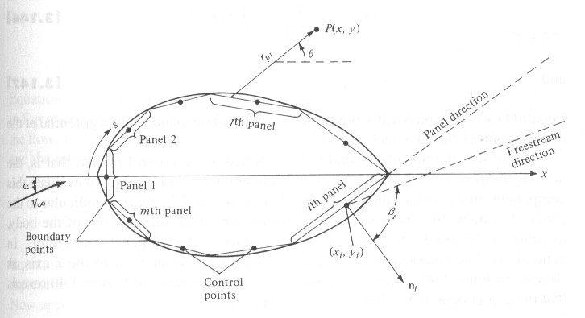
The vortex panel numerical method
Why to use this method
For airfoil thickness larger than 12%, or high angle of attack, results from thin airfoil theory are not good enough to agree with the experimental data.
Approach
Approximate the
airfoil surface by
a series of straight
panels with strength
which is to be
determined.

Slide 24
The velocity potential induced at P due to the j th panel is
The total potential at P
Put P at the control point of i th panel

Slide 25
The normal component of the velocity is zero at the control points, i.e.
We then have n linear algebraic equation with n unknowns.

Slide 26
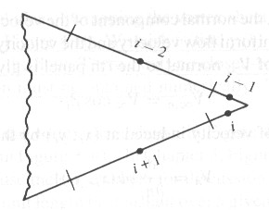
Kutta condition
To impose the Kutta condition, we choose to ignore one of the control points.
The need to ignore one of the control points introduces some arbitrariness in the numerical solution.

